Slide 1
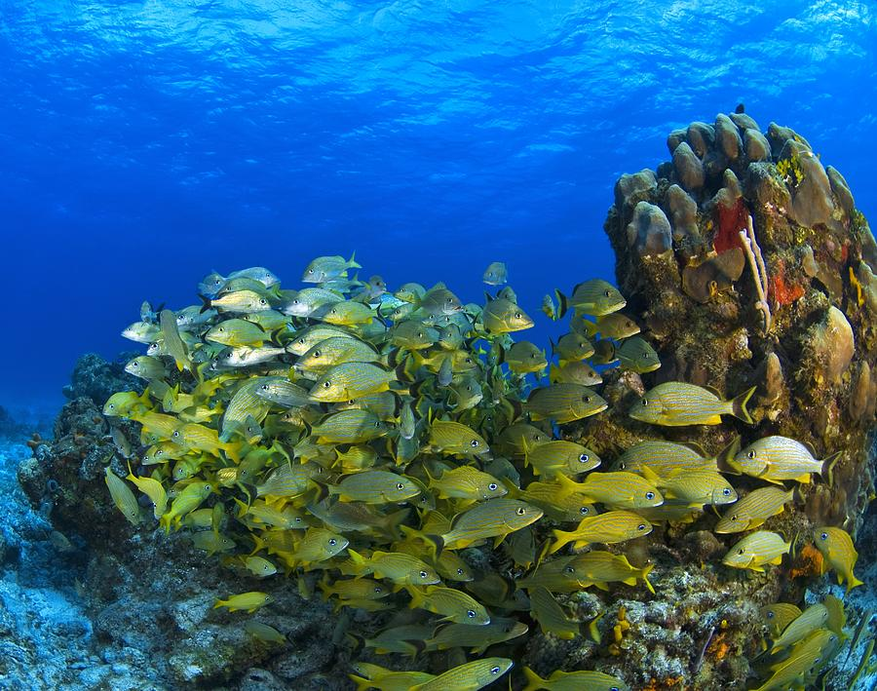
Fishing down nutrients:
altering coral reef ecosystems from the bottom up
  Jacob E. Allgeier¹, Craig A. Layman², Peter J. Mumby³, Amy D.Rosemond¹
  ¹Odum School of Ecology, University of Georgia, ²Marine Sciences Program, Florida International University, ³School of Biological Sciences University of Queensland

Slide 2
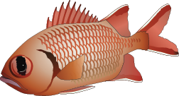

Slide 4
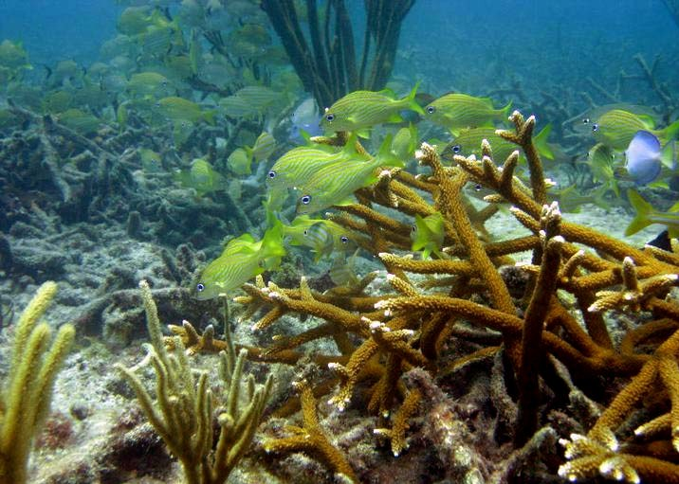
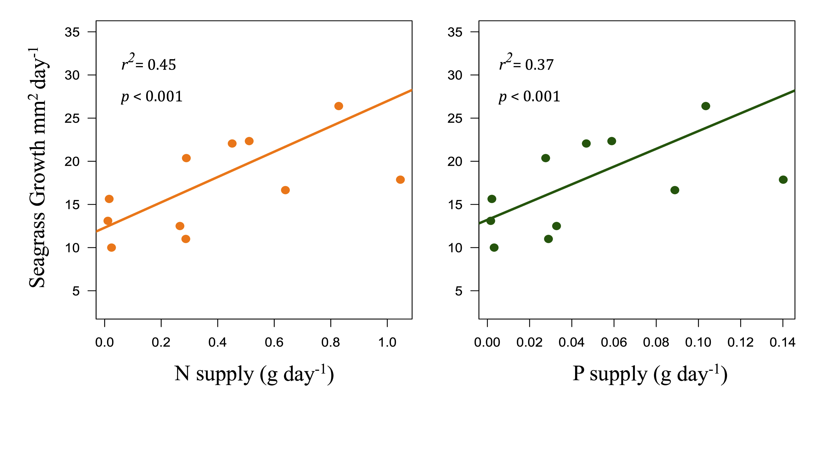
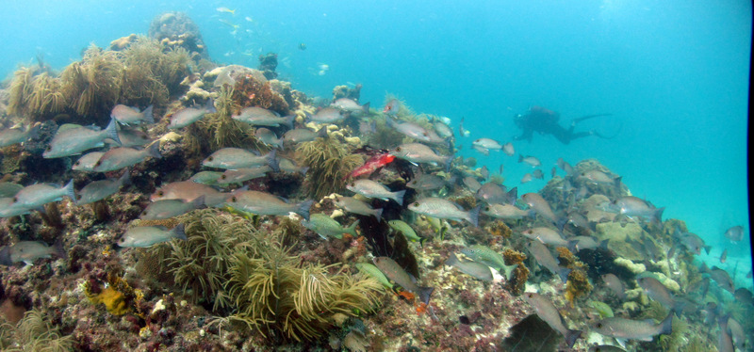
Implications for ecosystem function
Meyer et al. 1983
Allgeier et al. in revision
Burkepile et al. in review

Slide 5
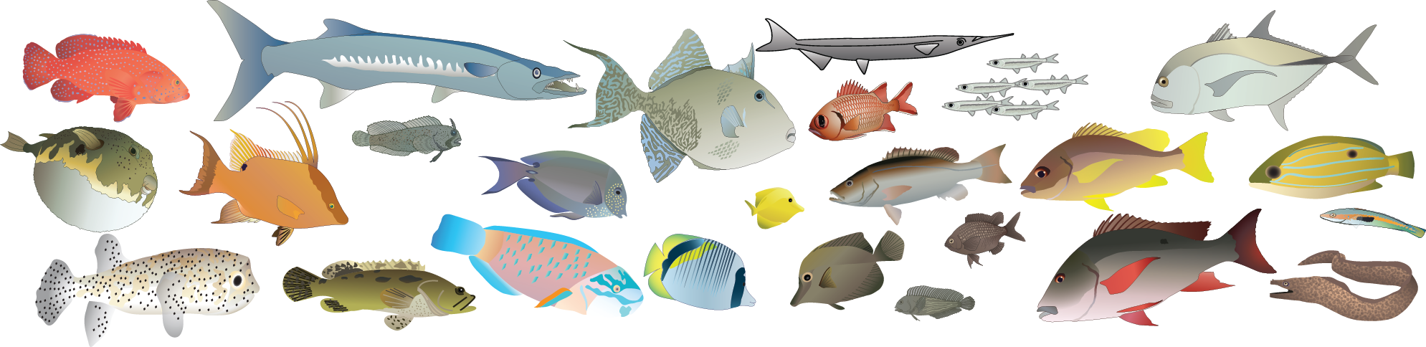


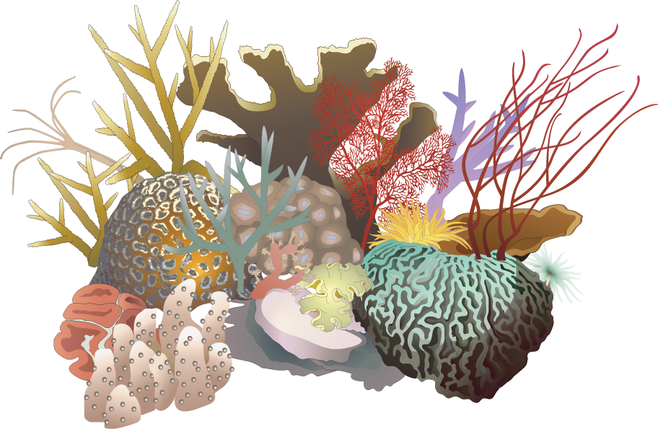
Nutrient pathways to coral reefs

Slide 6
Nutrient pathways to coral reefs
N:P
N:P
N:P

Slide 7
Nutrient pathways to coral reefs
N:P
N:P
N:P
N:P
N:P
N:P
N:P
N:P
N:P
N:P
N:P
N:P
N:P
N:P
N:P
N:P
N:P
N:P
N:P
N:P
N:P
N:P
N:P
N:P
N:P

Slide 8
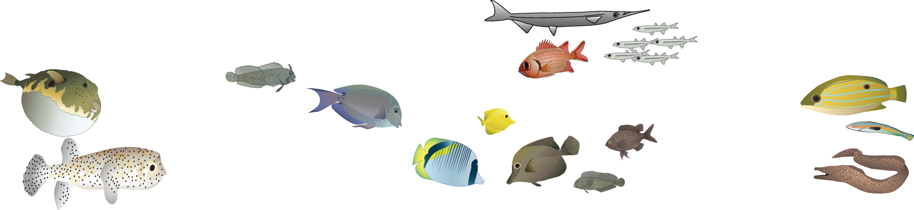
Overfishing
N:P
N:P
N:P
N:P
N:P
N:P
N:P
N:P
N:P
N:P
N:P
N:P
N:P
N:P
N:P

Slide 9
Overfishing - Nutrient Capacity
N:P
N:P
N:P
N:P
N:P
N:P
N:P
N:P
N:P
N:P
N:P
N:P
N:P
N:P
N:P

Slide 10
Objectives
Identify which community characteristics influence nutrient supply and retention by fish in coastal marine ecosystems
Identify how overfishing may be altering these processes

Slide 11
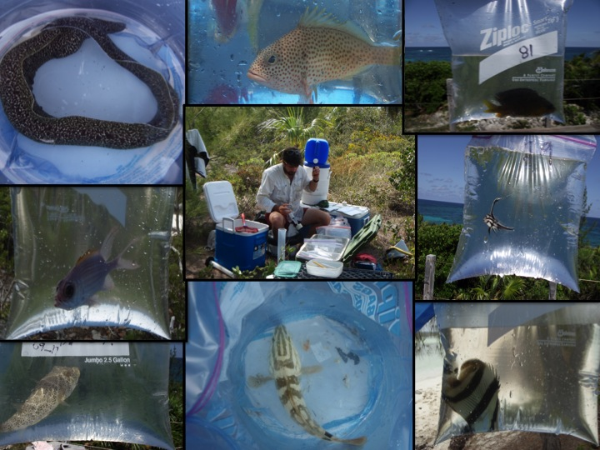
Empirical Excretion Rate Estimates
29 families
46 genera
76 species
>650 individuals

Slide 12
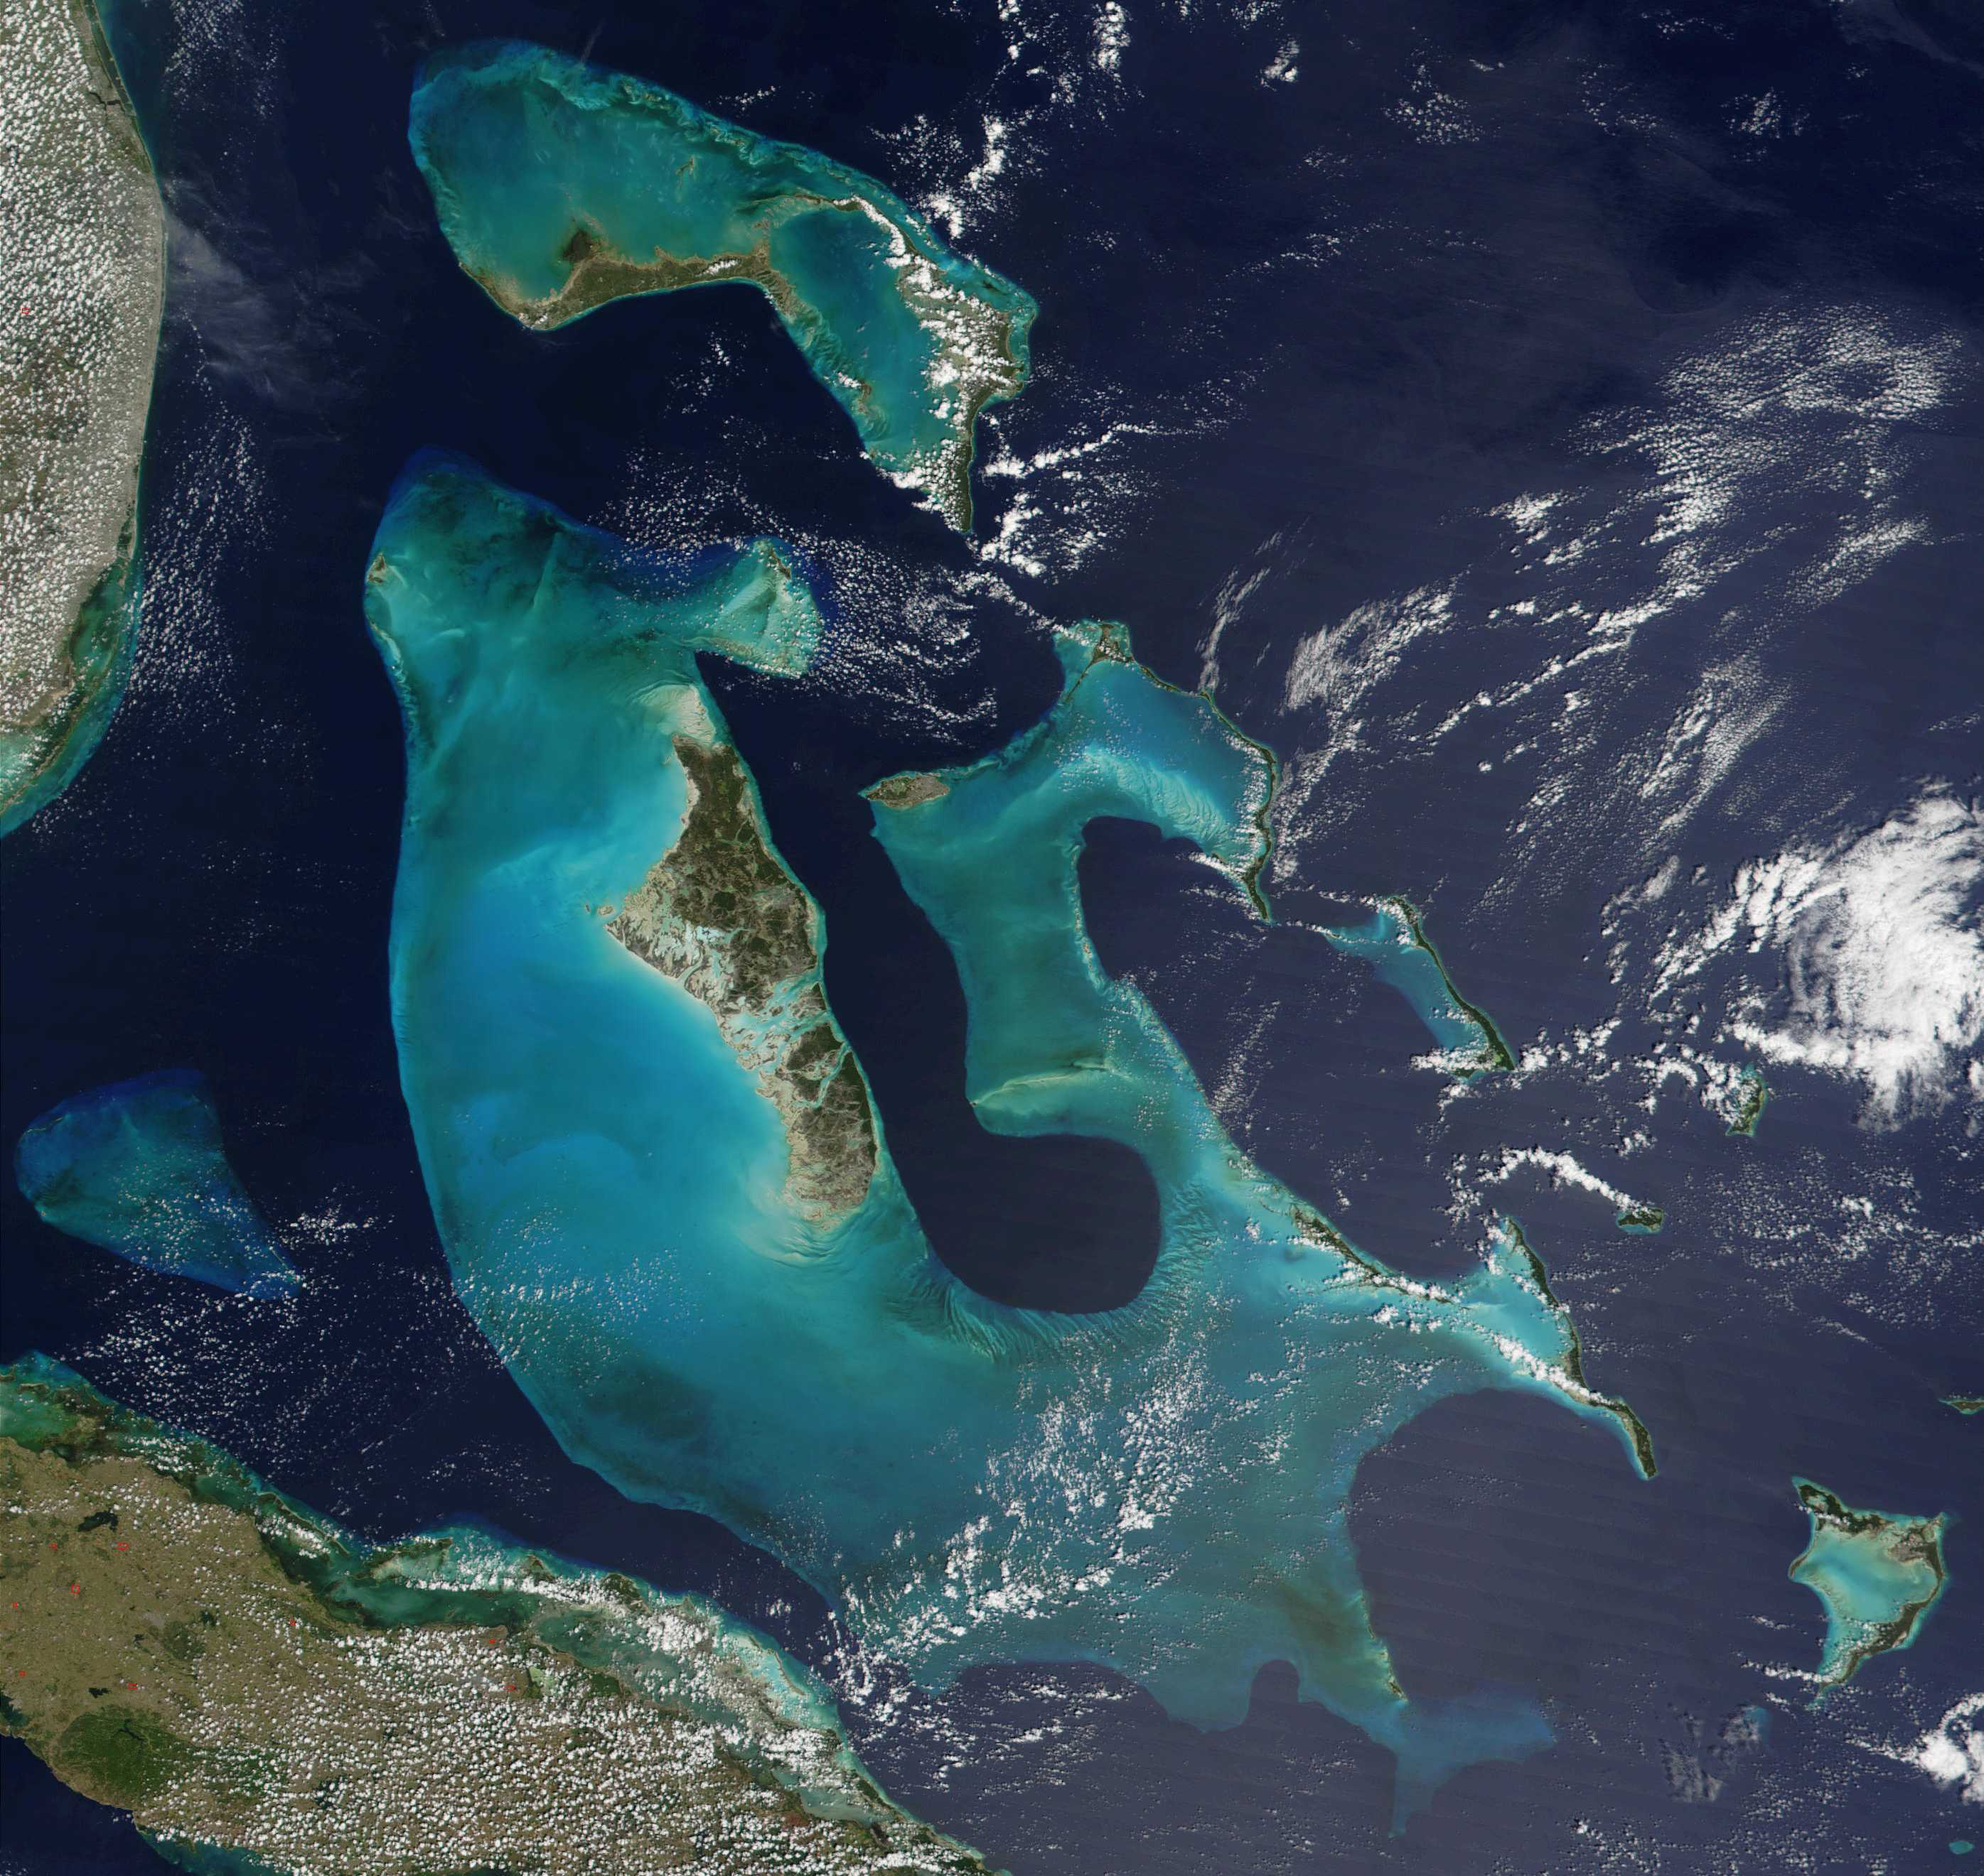
Surveys
  6 islands
  6 habitats
  172 sites
  same transect methods
Mumby et al. 2006
Harborne et al. 2008

Slide 13
GAMM Model Parameters
 | DIVERSITY |  | SIZE STRUCTURE |  | TROPHIC STRUCTURE
 | richness | sp. diversity | skewness | max length | mean TP | FFG diversity
N
P

Slide 14
Nutrient supply
 | DIVERSITY |  | SIZE STRUCTURE |  | TROPHIC STRUCTURE
 | richness | sp. diversity | skewness | max length | mean TP | FFG diversity
N | é | ê | é | é | é
P | é | ê | é | é | é
Strength in support of model

Slide 15
Nutrient storage
 | DIVERSITY |  | SIZE STRUCTURE |  | TROPHIC STRUCTURE
 | richness | sp. diversity | skewness | max length | mean TP | FFG diversity
N | é | ê | é | é | é | é
P | é | ê | é | é | é
Strength in support of model

Slide 16
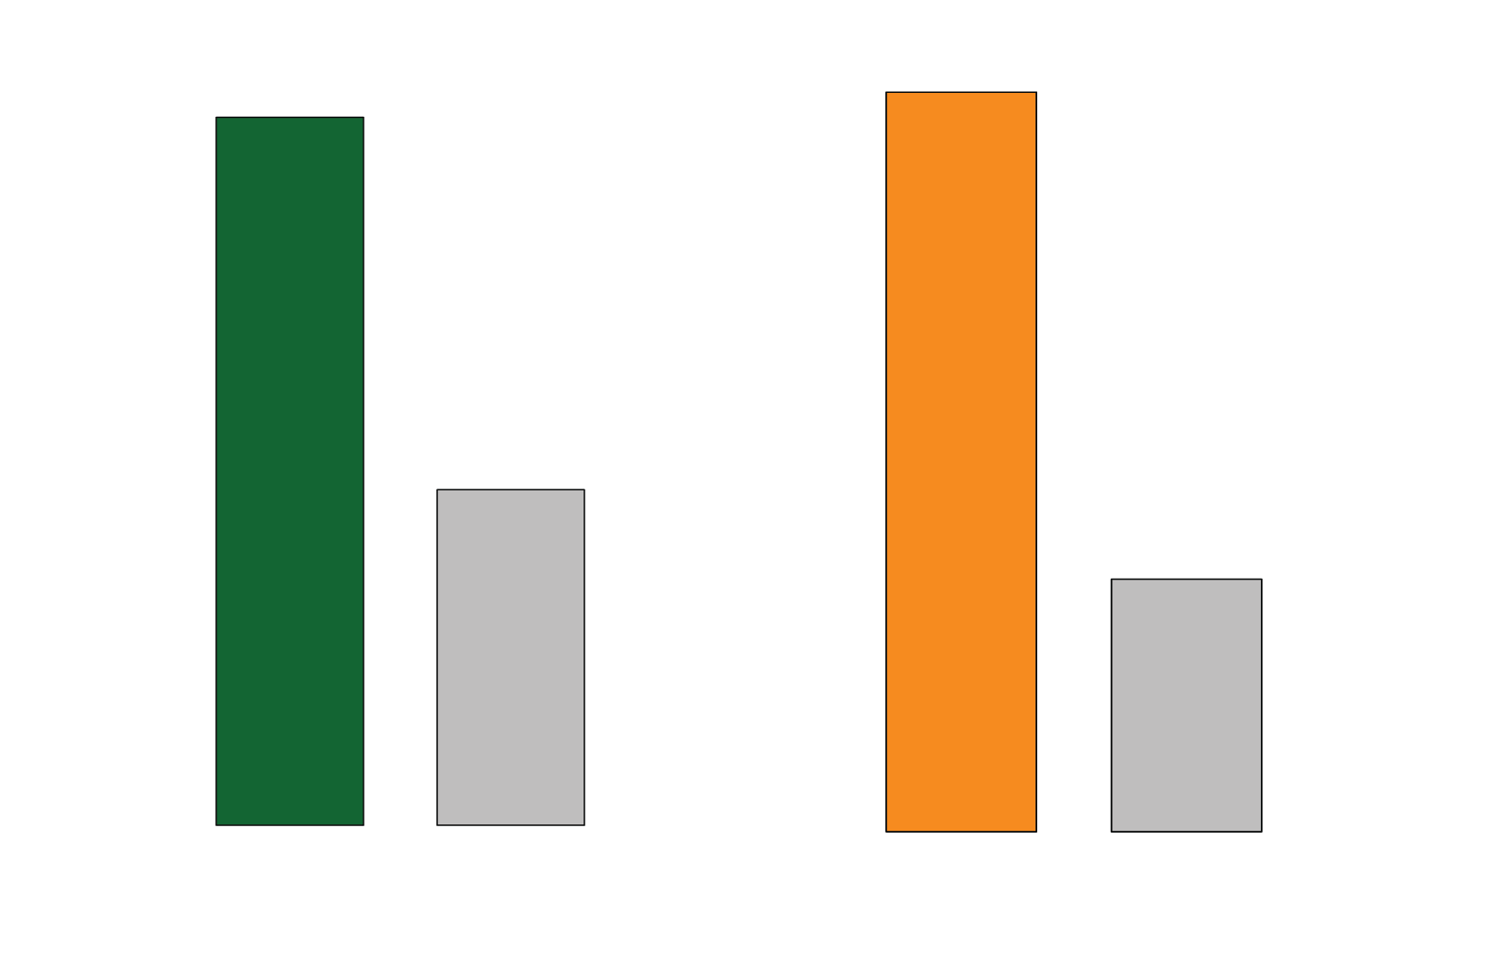
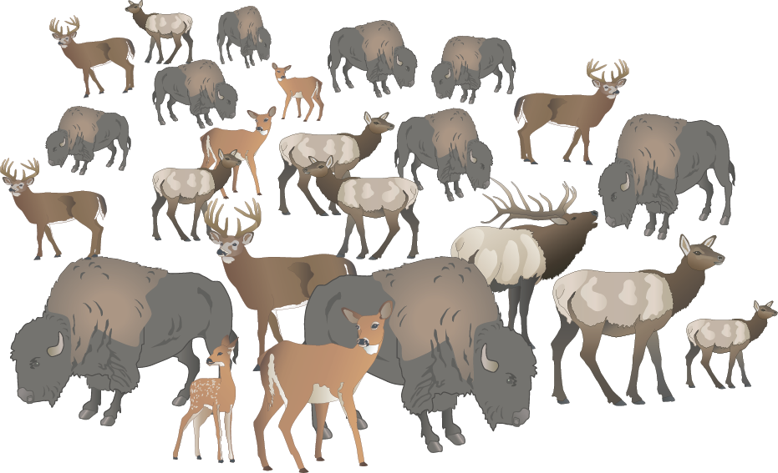
Overfishing
N supply from fishes g/m²/day
P supply from fishes g/m²/day
MPA
MPA
Not protected
Not protected

Slide 17
Conclusions
Species richness and the size structure of the community is critical
Species diversity is also important, but in a counter intuitive way (can have high richness and low diversity)
This research stresses the importance of integrating the bottom-up roll of consumers into models of coastal ecosystem function

Slide 18



Acknowledgments
Feedback from: Meredith Meyers, Clint Oakley, Dustin Kemp
Field and logistical support:
  Darlene Haines, Kaye Rennert, Rava Apollo, Jim Richards, Friends of the Environment, Lauren Yeager
Funding: EPA STAR Fellowship, NSF DDIG
Notes:
In our review we found: 1 – 2
In the case study we found:
Need more investigation

